Slide 1

1ABCT – 4th QTB / FY18
America’s First
Commander: COL CHARLES S. ARMSTRONG
CSM: CSM QUENTIN V. FENDERSON

Slide 2

Danger 6
OPENING REMARKS

Slide 3
Agenda
Brigade Inputs:
Division/Brigade Mission and Intent
Directed Missions, Tasks, Fielding, Support Requirements
Division Soldier Readiness
Brigade Commander’s Training Focus
METL Assessment: Current and Projected thru FY18
BDE Training Plan thru Q2 FY19
Key Collective Events
Projected Objective-T METL Crosswalk
Training Statistics: Individual / Crew / Troop Schools / 1ID Functional Training Courses
Brigade Leader Development Plan: Pre-CMD Course / CDR-1SG Course / CIP
CSM; Individual and NCO development plan
Brigade Showcase
Battalion Inputs:
Battalion Mission and Intent
Battalion METL Assessment
2nd Quarter / FY18 METL-Focused Training Highlight
3rd Quarter / FY18 METL-Focused Training Highlight
BRO Training Time (BTT) Execution
Brigade Inputs:
Key Resources Required to Train
Training Risks
Closing Comments / Discussion

Slide 4
1st Infantry Division Mission
The 1st Infantry Division and Fort Riley build and maintain combat ready forces; on order deploys these forces in an expeditionary manner to conduct Decisive Action to fight and win in complex environments as members of a Joint, Inter-organizational, and Multinational (JIM) team.

Slide 5
1st Infantry Division Commanders Intent
Expanded Purpose: Provide combat ready forces to combatant commanders to protect the United States and its interests at home and abroad. Provide a world class training and leader development environment and a community that supports and cares for Soldiers, Airmen, Civilians, Families, and Retirees.
Key Tasks:
(1) Build and Maintain Mission Readiness: Readiness is our decisive operation. All of our actions and energy should be spent on sustainable readiness in four areas: Personnel, Supply, Maintenance, and Training. The 1st Infantry Division will strive to increase deployable Soldiers percentages, execute innovative METL-focused training, enforce Command Discipline Programs, and maintain our equipment at 10/20 standards.
(2) Leader Development: The 1st Infantry Division and Fort Riley are leadership factories that build multi-dimensional, adaptive, and innovative professionals with an expeditionary mindset who are competent in their craft and are leaders of character, capable of supporting and carrying out our broad range of military operations in an expeditionary, complex environment.
(3) Teamwork: The 1st Infantry Division and Fort Riley fosters a climate of mutual trust and shared understanding to build teams that are capable of operating decentralized within the Commander’s Intent: internally, with higher, with adjacent units, with our Army Total Force, with JIM partners, and with our community.
(4) Care for our Soldiers, Airmen, Civilians, Families, and Retirees: The 1st Infantry Division and Fort Riley, in participation with our Greater Flint Hills community assist Soldiers, Airmen, Civilians, Families, and Retirees through engaged leaders, proactive programs, and world-class facilities to develop their resiliency. We cultivate a culture of rapid, expeditionary deployability where units and the installation rapidly deploy combat power globally.
Endstate: The 1st Infantry Division and Fort Riley maintain a world class reputation for fighting and winning when the nation calls, enabled through mutually beneficial relationships and enduring presence in the Flint Hills and Midwest Region; with infrastructure in place to project expeditionary combat power and sustain the installation’s people, training, and equipment.

Slide 6
Devil Brigade Mission
Devil Brigade builds readiness and lethal teams capable of rapidly deploying to conduct the full range of military operations to seize, retain, and exploit the initiative to accomplish any mission, any where, at any time.

Slide 7
Devil 6 Intent
Expanded Purpose: Return readiness to FORSCOM and support emerging CCMDR requirements.
Key Tasks:
Meet all IRC requirements.
Maintain high state of readiness with a non-deployable rate below 10% and OR rate above 90%.
Mitigate impact of personnel shortages by maximizing CDR / GNR teams.
Crew roster combat platforms, sustainment vehicles, Retrans. teams, and MC personnel alike.
No single task training events.
Develop and certify leaders through challenging and realistic training and comprehensive professional development.
Master Individual Soldier Tasks and Drills, collective tasks, and METL tasks through Mission Command and Multi-Echelon training.
Care for Devil Soldiers and Families through responsive and engaged Leaders.
Systematically track critical (non-pacing) mission-essential equipment.
End State:
Devil Brigade is complete with collective training with personnel and equipment ready for deployment. Training time is efficiently used and Soldiers have opportunities to enjoy personal time prior to deployment. Total Force and community partners maximize training opportunities and increase Soldier’s quality of life. Families are integrated in FRGs and prepared for unit deployment.
Notes:
PIM removed

Slide 8
Directed Missions, Tasks, Fielding, Support Requirements
Assigned Missions (if applicable): NTC 18-10 (28 AUG – 14 SEP); SUB-T OPS MTT-A (25 – 27 SEP); IRC Mission (thru 31 JUL), Cost of Training Readiness
External Assigned Tasks: None
Division Assigned Tasks: Maintenance Terrain Walk (19 JUL, 25 – 26 JUL, 31 JUL – 02 AUG); CTLT (23 JUL – 08 AUG); Umbrella Week (23 – 27 JUL); Victory Week (04 – 10 AUG); Best Medic (14 – 16 AUG); Fall Apple Day (22 SEP)
Fielding Requirements: None
Training Requirements: Rear-D Certification (09 – 12 JUL); BDE FiST Cert (16 – 27JUL); Sustainment Gunnery (23 – 27 JUL); Devil Foundation 2 (30 JUL – 03 AUG);
PST Requirements: 179 PAX 4QTR FY18, FRKS ASF
Community Support Requirements: Adopt-a-School (3x schools per BN)

Slide 9
Devil Brigade Task Organization
x
1/1ID
ADCON to 1EN
HHC/1/1ID
E
BSB
1-16
2-34
3-66
1-4
1-5
1EN
101
E
HHC/1-16
HHC/2-34
HHC/3-66
HHT/1-4
HHB/1-5
HHC/1EN
HHC/101
A/1-16
A/2-34
A/3-66
A/1-4
A/1-5
E
A/101
A/1EN
B/1-16
E
B/2-34
B/3-66
B/1-4
B/1-5
B/1EN
B/101
C/1-16
C/2-34
C/3-66
C/1-4
D/1-5
C/1EN
C/101
Raven: 1
FSC
FSC
FSC
FSC
M I
G/101
H/101
I/101
D/1-4
F/101
D/1EN
KEY
RECON
M105: 18
TPQ 53: 2
Raven: 3
I
FSC
OPCON
FSC
E/101
D/101
TACON
E
41EN
FiST 1-5
FiST 1-5
FiST 1-5
FiST 1-5
ATTACHED
M2A3: 16
ABV: 6
AVLB: 4
D-7RII: 6
M1A2: 15
M2A3: 32
M3A3: 4
M1064: 4
Raven: 2
IN SQD: 16
Javelin: 12
M1A2: 29
M2A3: 18
M3A3: 4
M1064: 4
Raven: 3
IN SQD: 8
Javelin: 6
M1A2: 29
M2A3: 18
M3A3: 3
M1064: 4
Raven: 3
IN SQD: 8
Javelin: 6
M1A2: 14
M2A3: 41
M3A3: 3
M1064A3: 6
Raven: 5
Javelin: 12
Raven: 2
Shadow; 4
Javelin: 4
ADCON

Slide 10
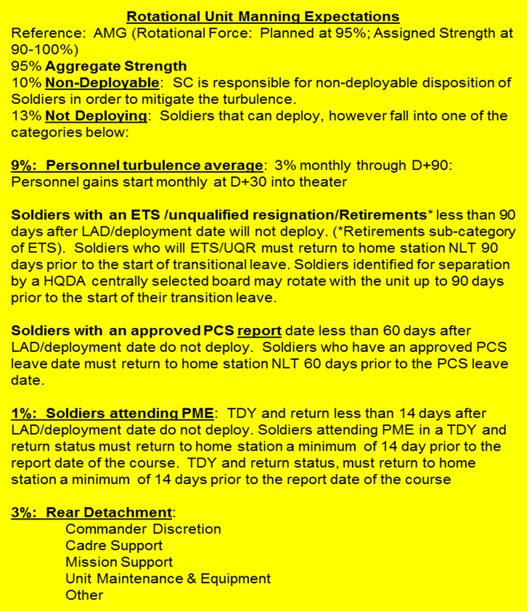
Devil Brigade Deployability Snapshot
Authorized strength: 4189
Assigned strength: 4191 (100%)
Deployable: 3752 (89.5%)
439 Soldiers non-deployable (10.5%)
Available: 3225 (77%)
Not avaliable: 527 Soldiers (12.6%)
401 Soldiers on orders (9.6%)
201 PCS
179 ETS
21 Retire (approved orders on hand)
126 Soldiers on rear detachment (3%)
as of 21 June 18
**Deployment goal - 82% of theater requirement
__% Deployed __% Against FTN ___ Total BOG (Rotation)
Notes:
Authorized Strength – 2/1 ID MTOE (16 Oct 16)
Assigned Strength – current 21i strength in TOPMIS (Off/WO) & EDAS
Assigned Strength percentage - Assigned Strength divided by Authorized strength
Deployable – Assigned Strength minus the Non-Deployable
Deployable percentage – Deployable divided by the Assigned Strength
Non-deployable percentage – Non-deployable divided by the Assigned Strength
BCT Deployed – Current Deployable minus Current Not Deploying
BCT Deployed percentage – BCT Deployed divided by the Authorized Strength
Not Deploying – Total number of Soldiers that will PCS, ETS, or Retire (using the above Rotational Unit Manning Expectations). This section also includes the number of Soldiers assigned as Rear Detachment Cadre

Slide 11
Devil 6 Training Focus
Readiness: “ANY MISSION, ANY WHERE, ANY TIME”
Excel at Fundamentals (Communicate / Sustain / Shoot / Move / Medical / CBRNE).
Sustain IRC for assumption of mission 23 MAR – 31 JUL 18.
Dominate Blackhorse during NTC 18-10.
Codify lessons learned from IRC, Devil Prowl, and Gauntlet by incorporating and updating current SOPs.
Aggressively exercise Mission Command Systems (digital / analog) that are sustainable in a Decisive Action Environment.
Foster and maintain a team-oriented organization that empowers Leaders to exercise Disciplined Initiative that is reinforced through engaged positive leadership.
Care for Devil Soldiers, Civilians, and Families, and foster Community Partnership.

Slide 12
Devil Brigade Training Calendar 4th Quarter

Slide 13
Devil Brigade METL Assessment – 4th Quarter
Task # | MET | Current-Beginning of Quarter | Training Events Impacting METL Assessment | Projected-End of Quarter
17-BDE-1030 | Conduct an Area Defense | T- | BDE FiST Cert., NTC 18-10 | T
17-BDE-1074 | Conduct a Movement to Contact | T- | BDE FiST Cert., NTC 18-10 | T
17-BDE-1094 | Conduct an Attack | T- | BDE FiST Cert., NTC 18-10 | T
07-BDE-1272 | Conduct Area Security | T- | NTC 18-10 | T
55-BDE-4800 | Conduct Expeditionary Deployment Operations | T- | SCI, NTC 18-10 | T
DA Standardized METL: Effective Date-XX

Slide 14
Projected Objective-T METL Crosswalk (Conduct an Attack)
Plan and Prepare |  |  |  |  |  | Execute |  |  |  |  |  | Assess
Operational Environment |  |  |  | LFX | Training Environment (L/V/C/G) | % Leaders Present at Training / Required | % Present at Training / Required | External Evaluation | Performance Measures | Critical Performance Measures | Leader Performance Measures | Task Assessment
SQD & PLT | CO & BN | BDE & ABOVE
Dynamic (Single Threat) | Dynamic & Complex (4+ OE Variables & Hybrid Threat) | Dynamic & Complex (All OE Variables & Hybrid Threat) | Night | Yes | Proponent Establishes Training Environment Standards (FTX, STX, CPX, STAFFEX, TEWT, etc) | ≥ 85% | ≥ 80% | YES | ≥ 90% GO | ALL GO | ≥ 90% GO | T
 |  |  |  |  |  | 75 – 84% |  |  | 80 – 89% GO |  | 80 – 89% GO | T-
Static (Single Threat) | Dynamic (Single Threat) | Dynamic & Complex (All OE Variables & Single Threat) |  | No |  | 65 – 74% | 75 – 79% | NO | 65 – 79% GO |  |  | P
 |  |  | Day |  |  | 60 – 64% | 60 – 74% |  | 50 – 64% GO | NOT ALL GO | < 80% GO | P-
 | Static (Single Threat) | Dynamic Complex (< All OE Variables & Single Threat) |  |  |  | < 60% | < 60% |  | < 50% GO |  |  | U
Task Dependent
Task Independent
Notes:
Conduct an Attack (17-BDE-1094)
SCT 1: Conduct Countermobility Activities (07-BDE-6082)
SCT 2: Conduct Reconnaissance Activities (17-BDE-1007)
SCT 3: Employ Fires (06-BDE-5066)
SCT 4: Conduct a Combined Arms Breach of an Obstacle (ABCT) (07-BDE-1254)
SCT 5: Provide Internal Sustainment (Brigade) (63-BDE-4021)
SCT 6: Coordinate Air-Ground Operations when Providing Atk Avn Spt (01-6-0436)
SCT 7: Conduct the Brigade Mission Command Operations Process (71-BDE-5100)

Slide 15
DTMS – 350-1 Training
Unit | ANTI-TERRORISM (AT) | THREAT AWARENESS REPORTING PROGRAM (TARP) | ARMY SUBSTANCE ABUSE PROGRAM (ASAP) | ASK, CARE, ESCORT SUICIDE PREVENTION AND AWARENESS (ACE) | EQUAL OPPORTUNITY (EO) | SHARP TRAINING (SOLDIER/CIVILIAN)
1ABCT | 6% | 12% | 36% | 13% | 24% | 24%
1-16 IN | 7% | 3% | 13% | 23% | 9% | 8%
2-34 AR | 2% | 1% | 14% | 2% | 4% | 7%
3-66 AR | 15% | 3% | 12% | 6% | 16% | 32%
1-4 CAV | 2% | 4% | 20% | 11% | 16% | 21%
1-5 FA | 2% | 4% | 20% | 15% | 5% | 4%
1 EN | 3% | 4% | 18% | 41% | 51% | 32%
101 BSB | 15% | 68% | 50% | 30% | 67% | 76%
>90% of assigned unit personnel
70% - 89% of assigned unit personnel
50% - 69%% of assigned unit personnel
<50% of assigned unit personnel
Notes:
*ASAP and ACE removed per AD 2018-07

Slide 16
Troop Schools
COURSE TITLE | Class Stats |  |  | 1ABCT |  |  | 1-16 IN |  |  | 2-34 AR |  |  | 3-66 AR |  |  | 1-4 CAV |  |  | 1-5 FA |  |  | 1 EN |  |  | 101 BSB
 | MIN | MAX | SCH | REQ | O/H | SCH | REQ | O/H | SCH | REQ | O/H | SCH | REQ | O/H | SCH | REQ | O/H | SCH | REQ | O/H | SCH | REQ | O/H | SCH | REQ | O/H | SCH
Ammunition Handler | 10 | 25 |  | 112 | 138 |  | 12 | 8 |  | 12 | 4 |  | 12 | 21 | 7 | 12 | 13 | 2 | 20 | 58 | 3 | 20 | 21 | 5 | 12 | 13
31-Jul
21-Aug |  |  |  |  |  | 11
Armorer | 8 | 24 |  | 80 | 130 |  | 12 | 10 |  | 12 | 27 | 2 | 12 | 15 |  | 12 | 26 | 1 | 10 | 25 | 2 | 12 | 19 | 4 | 8 | 8
31-Jul |  |  |  |  |  | 2
11-Sep |  |  |  |  |  | 10
Arms Room Supervisor | 8 | 24 |  | 48 | 22 |  | 6 | 4 |  | 6 | 0 | 1 | 6 | 6 |  | 6 | 2 | 1 | 10 | 1 |  | 4 | 3 | 1 | 4 | 6
24-Oct-1-Nov
Bus Driver | 8 | 12 |  | 71 | 48 |  | 12 | 6 |  | 12 | 12 | 0 | 12 | 4 |  | 12 | 9 |  | 10 | 10 |  | 5 | 4 |  | 8 | 3
6-Sep
18-Sep
Company Commander 1SG Pre-command Course | 8 | 45 |  | 84 | 72 |  | 12 | 10 |  | 12 | 9 |  | 12 | 9 |  | 14 | 11 |  | 12 | 11 |  | 12 | 14 |  | 10 | 8
18-Sep |  |  |  |  |  | 4
DTMS v7 | 10 | 16 |  | 81 | 86 |  | 10 | 6 |  | 10 | 4 |  | 10 | 15 |  | 7 | 8 |  | 12 | 19 |  | 14 | 16 | 2 | 15 | 18
7-Aug |  |  |  |  |  | 2
28-Aug |  |  |  |  |  | 3
Fuel Handler | 8 | 24 |  | 36 | 50 |  | 2 | 0 |  | 2 | 5 |  | 2 | 2 |  | 2 | 8 |  | 2 | 1 |  | 6 | 9 |  | 20 | 25
Master Driver |  |  |  | 64 | 52 |  | 10 | 5 |  | 10 | 9 |  | 10 | 9 |  | 12 | 6 |  | 10 | 13 |  | 6 | 8 | 2 | 4 | 2
21-Aug |  |  |  |  |  | 2
25-Sep |  |  |  |  |  | 2
MILES | 2 | 25 |  | 81 | 53 |  | 10 | 4 |  | 10 | 1 |  | 10 | 4 |  | 12 | 8 |  | 10 | 12 |  | 13 | 12 |  | 12 | 12
TCAIMS II Unit Movement | 8 | 27 |  | 84 | 46 |  | 12 | 4 |  | 12 | 6 | 2 | 12 | 4 | 1 | 14 | 6 | 9 | 12 | 8 | 2 | 12 | 6 | 4 | 10 | 12
14-May |  |  |  |  |  | 1
REQ is number required by formation
O/H is On hand in formation.
SCH is the number scheduled for the next class
Color code the O/H column accordingly
Satisfies Requirement
> 80% of requirement
< 80% of requirement

Slide 17
Troop Schools
COURSE TITLE | Class Stats |  |  | 1ABCT |  |  | 1-16 IN |  |  | 2-34 AR |  |  | 3-66 AR |  |  | 1-4 CAV |  |  | 1-5 FA |  |  | 1 EN |  |  | 101 BSB
 | MIN | MAX | SCH | REQ | O/H | SCH | REQ | O/H | SCH | REQ | O/H | SCH | REQ | O/H | SCH | REQ | O/H | SCH | REQ | O/H | SCH | REQ | O/H | SCH | REQ | O/H | SCH
UMODPC (8C-F17/553-F5(MC) New class name* | 12 | 24 |  | 74 | 34 | 24 | 10 | 0 |  | 10 | 0 |  | 10 | 5 | 5 | 12 | 12 | 2 | 12 | 5 | 11 | 12 | 6 | 4 | 6 | 6
18-aug17 |  |  | 25
Technical Transport of Hazardous Materials (Cert) (SchoolCode910R) | 15 | 34 |  | 74 | 47 |  | 10 | 6 |  | 10 | 0 |  | 10 | 6 | 1 | 12 | 6 |  | 12 | 17 | 5 | 12 | 6 | 2 | 6 | 6
14-Aug |  |  |  |  |  |  |  |  |  |  |  |  |  |  |  |  |  | 1
11-Sep
MG Common Core | 16 | 64 |  | 20 | 13 |  | 4 | 1 |  | 4 | 1 |  | 4 | 2 |  | 6 | 5 |  | 0 | 0 |  | 0 | 1 |  | 0 | 0
8-Aug |  |  |  |  |  |  |  |  |  |  |  |  |  |  |  |  |  | 1
M1A2 MG | 6 | 18 |  | 10 | 5 |  | 2 | 1 |  | 3 | 0 |  | 3 | 4 |  | 2 | 0 |  | 0 | 0 |  | 0 | 0 |  | 0 | 0
14-Sep
M2 MG | 15 | 36 |  | 14 | 10 |  | 3 | 1 |  | 2 | 1 |  | 2 | 1 |  | 4 | 5 |  | 0 | 0 |  | 2 | 1 |  | 0 | 0
14-Sep
H8 Wheeled | 4 | 18 |  | 39 | 22 |  | 3 | 0 |  | 3 | 0 |  | 3 | 0 |  | 12 | 5 | 1 | 5 | 5 | 0 | 9 | 8 | 3 | 4 | 4
20 School Locations 18 classes
H8 Tracked | 4 | 21 |  | 58 | 23 |  | 12 | 0 |  | 12 | 1 |  | 12 | 4 | 1 | 7 | 8 | 0 | 5 | 5 | 0 | 10 | 5 | 7 | 0 | 0
6 School Locations 6 classes
Air load Planner Course / ICODES | 15 | 25 |  | 18 | 20 |  | 2 | 1 |  | 2 | 2 |  | 2 | 2 |  | 2 | 8 |  | 2 | 1 | 1 | 6 | 5 | 1 | 2 | 1
CCO( Container Certify Officer |  |  |  | 76 | 45 |  | 10 | 0 |  | 10 | 0 |  | 10 | 12 |  | 12 | 15 |  | 10 | 9 | 1 | 12 | 3 | 9 | 10 | 6
REQ is number required by formation
O/H is On hand in formation.
SCH is the number scheduled for the next class
Color code the O/H column accordingly
Satisfies Requirement
> 80% of requirement
< 80% of requirement

Slide 18
1ID Functional Training Courses
COURSE TITLE | Class Stats |  |  | 1ABCT |  |  | 1-16 IN |  |  | 2-34 AR |  |  | 3-66 AR |  |  | 1-4 CAV |  |  | 1-5 FA |  |  | 1 EN |  |  | 101 BSB
 | MIN | MAX | SCH | REQ | O/H | SCH | REQ | O/H | SCH | REQ | O/H | SCH | REQ | O/H | SCH | REQ | O/H | SCH | REQ | O/H | SCH | REQ | O/H | SCH | REQ | O/H | SCH
RANGER | 100 | 310 |  | 17 | 44 |  | 6 | 15 |  | 3 | 8 |  | 3 | 11 | 1 | 5 | 6 |  | 0 | 0 |  | 0 | 4 |  | 0 | 0
SNIPER | 24 | 48 |  | 9 | 12 |  | 3 | 3 |  | 3 | 3 |  | 3 | 4 | 2 | 0 | 2 |  | 0 | 0 |  | 0 | 0 |  | 0 | 0
Battle Staff NCO Course |  |  |  | 16 | 6 |  | 2 | 0 |  | 2 | 2 |  | 2 | 1 |  | 2 | 2 | 0 | 2 | 0 |  | 2 | 0 |  | 2 | 0
 |  |  |  |  |  |  |  |  |  |  |  |  |  |  |  |  |  |  |  |  |  |  |  |  | 2 | 2
BFV MG | 15 | 36 |  | 15 | 15 |  | 3 | 5 |  | 2 | 2 |  | 2 | 4 |  | 4 | 3 | 1 | 0 | 0 |  | 3 | 1 |  | 0 | 0
INFANTRY MORTAR LC | 30 | 72 |  | 15 | 15 |  | 3 | 3 |  | 3 | 2 |  | 3 | 5 | 1 | 6 | 5 | 2 | 0 | 0 |  | 0 | 0 |  | 0 | 0
BRADLEY LC | 20 | 40 |  | 44 | 43 |  | 12 | 13 |  | 10 | 10 |  | 10 | 10 |  | 12 | 8 |  | 0 | 0 |  | 0 | 2 |  | 0 | 0
SAPPER LC | 25 | 30 |  | 25 | 18 |  | 0 | 0 |  | 0 | 0 |  | 0 | 1 |  | 0 | 0 |  | 0 | 0 |  | 25 | 17 |  | 0 | 0
RECON & SURV LC | 24 | 54 |  | 18 | 5 |  | 2 | 1 |  | 2 | 1 |  | 2 | 1 |  | 12 | 1 | 2 | 0 | 0 |  | 0 | 1 |  | 0 | 0
Courses in Blue need to be requested min. 6 month prior.
REQ is number required by formation
O/H is On hand in formation.
SCH is the number scheduled for the next class
Color code the O/H column accordingly
Satisfies Requirement
> 80% of requirement
< 80% of requirement

Slide 19
1ID Functional Training Courses
COURSE TITLE | Class Stats |  |  | 1ABCT |  |  | 1-16 IN |  |  | 2-34 AR |  |  | 3-66 AR |  |  | 1-4 CAV |  |  | 1-5 FA |  |  | 1 EN |  |  | 101 BSB
 | MIN | MAX | SCH | REQ | O/H | SCH | REQ | O/H | SCH | REQ | O/H | SCH | REQ | O/H | SCH | REQ | O/H | SCH | REQ | O/H | SCH | REQ | O/H | SCH | REQ | O/H | SCH
ARMY RECON COURSE | 45 | 60 |  | 18 | 29 |  | 2 | 1 |  | 2 | 6 |  | 2 | 14 |  | 12 | 7 | 2 | 0 | 0 |  | 0 | 1 |  | 0 | 0
MSN CmD DIG MG | 2 | 8 |  | 7 | 6 |  | 1 | 0 |  | 1 | 1 |  | 1 | 0 |  | 1 | 0 |  | 1 | 2 |  | 1 | 3 |  | 1 | 0
SIGNAL DIG MG | 8 | 16 |  | 7 | 1 |  | 1 | 1 |  | 1 | 0 |  | 1 | 0 |  | 1 | 0 |  | 1 | 0 |  | 1 | 0 |  | 1 | 0
AIR ASSAULT | 50 | 240 |  | 37 | 124 |  | 5 | 21 |  | 5 | 35 |  | 5 | 5 |  | 6 | 17 |  | 5 | 24 |  | 6 | 12 |  | 5 | 10
SHARP | 16 | 32 |  | 36 | 30 |  | 5 | 3 |  | 5 | 10 | 1 | 5 | 5 |  | 6 | 1 |  | 5 | 2 |  | 6 | 5 |  | 4 | 4
 |  |  |  | 0 | 15
MASTER FITNESS TRAIINER | 12 | 32 |  | 36 | 15 |  | 5 | 3 |  | 5 | 2 |  | 5 | 2 |  | 6 | 2 |  | 5 | 1 |  | 6 | 3 |  | 4 | 2
POSTAL OPERATIONS | 20 | 30 |  | 14 | 9 |  | 2 | 1 |  | 2 | 2 |  | 2 | 2 |  | 2 | 0 |  | 2 | 2 |  | 2 | 2 |  | 2 | 0
JOINT FIRES AND EFFECTS | 20 | 28 |  | 16 | 24 |  | 0 | 0 |  | 0 | 0 |  | 0 | 0 |  | 0 | 0 |  | 16 | 24 |  | 0 | 0 |  | 0 | 0
Courses in Blue need to be requested min. 6 month prior.
REQ is number required by formation
O/H is On hand in formation.
SCH is the number scheduled for the next class
Color code the O/H column accordingly
Satisfies Requirement
> 80% of requirement
< 80% of requirement

Slide 20
Ammunition Forecast and Expenditure
Previous Quarter Training Focus:
Devil Prowl
Gauntlet

Slide 21
BDE/BN Pre-Command Course
ASSUMED
COMMAND
PH I
PH II
PH III
PH IV
FUNCTIONAL
COURSES
FIRES ORIENT
COURSE
1st ABCT
12 JUL 17
1-16 IN
02 MAR 18
2-34 AR
09 MAR 18
3-66 AR
14 MAR 18
1-4 CAV
11 JUL 17
1-5 FA
05 APR 18
1ST EN BN
21 MAR 18
101 BSB
18 JAN 18
LEGEND
Phase I: Mission Command
Phase II: Tactical Leaders Course
Phase III: Branch Course
Phase IV: Senior Officer Legal Orient Course
Phase or course completed prior to assuming command
Phase or course completed within 90 days of assuming command
Phase or course not yet completed—date scheduled
As of 11 Aug 17 Updated by BDE
As of 20180619

Slide 22
Company Commander/1SG Pre-Command Course
FIRST SERGEANT
COMPANY COMMANDER
FIRST SERGEANT
1st ABCT
HHC
Rear
HHC
Rear
1-16 IN
HHC
A
B
HHC
A
B
C
FSC
Rear
C
FSC
Rear
2-34 AR
HHC
A
B
HHC
A
B
C
FSC
Rear
C
FSC
Rear
3-66 AR
HHC
A
B
HHC
A
B
C
FSC
Rear
C
FSC
Rear
1-4 CAV
HHT
A
B
Rear
HHT
A
B
Rear
C
D
FSC
C
D
FSC
1-5 FA
HHB
A
B
HHB
A
B
D
FSC
Rear
D
FSC
Rear
1ST EN BN
HHC
A
B
Rear
HHC
A
B
Rear
C
D
FSC
C
D
FSC
101 BSB
HHC
A
B
HHC
A
B
C
Rear
C
Rear
Attended CCFS PCC prior to assuming position
Attended CCFS PCC after assuming position (and has a General Officer waiver)
Did not attend CCFS PCC/No General Officer waiver

Slide 23
Command Inspection Program
BN
CO/TRP/BTRY
ASSUMED
COMMAND
ICI
ICI
COC
1st ABCT
12 JUL 17
29 SEP 17
HHC
HHC
04 OCT 17
HHC
A
B
HHC
15 MAR 18
A
15 JAN 18
B
13 OCT 17
1-16 IN
02 MAR 18
22 MAY 18
C
11 MAY 17
FSC
17 MAY 17
C
FSC
HHC
A
B
HHC
10 APR 18
A
27 OCT 17
B
06 MAY 18
2-34 AR
09 MAR 18
22 MAY 18
C
11 MAR 18
FSC
17 MAY 17
C
FSC
3-66 AR
HHC
A
B
HHC
06 APR 18
A
28 AUG 17
B
11 AUG 17
14 MAR 18
24 MAY 18
C
08 DEC 17
FSC
15 FEB 18
C
FSC
11 JUL 17
19 SEP 17
HHT
A
B
HHT
31 MAR 17
A
07 NOV 17
B
05 OCT 17
1-4 CAV
C
D
FSC
C
01 MAR 18
D
09 MAR 18
FSC
30 AUG 17
1-5 FA
HHB
A
B
HHB
02 DEC 17
A
17 OCT 17
B
10 SEP 17
05 APR 18
14 MAY 18
D
FSC
D
09 MAR 18
FSC
10 SEP 17
1ST EN BN
21 MAR 18
14 MAY 18
HHC
A
B
HHC
16 MAR 18
A
11 MAY 18
B
16 MAR 18
C
D
FSC
C
29 MAR 18
D
06 APR 18
FSC
14 MAR 17
101 BSB
18 JAN 18
23 MAR 18
HHC
A
B
HHC
15 DEC 17
A
15 DEC 17
B
16 DEC 17
C
C
16 DEC 17
ICI conducted within 90 days of command
ICI conducted after 90 days of command
ICI not conducted

Slide 24
Devil’s Road to NTC
NOV
DEC
JAN
FEB
MAR
APR
MAY
JUN
JUL
AUG
SEP
OCT
NOV
DEC
BRIGADE 45-Day Training
DEVIL PROWL
GAUNTLET
EUCOM
SUST GNRY
SUST GNRY
NTC 18-10
PIM
LTP
BLK LVE
III Corps CTC Validation
BDE/BN Mission Command
STAFFEX (5-6 MAR)
TOCEX (7-8 MAR)
LTP (16-23 MAY)
CPX I-III (12-16 MAR) , (10 APR – 06 MAY), (31 MAY– 20 JUN)
Fires Rehearsal
DvP, Gauntlet
TACSOP (CO/BN/BCT)
Under Review
Maneuver BN FTX
Devil Prowl
CO STX/LFX:
Devil Focus (10 APR - 06 MAY)
DEVIL PROWL
(10 APR – 07 MAY)
CPX EVENT II
PRIMARY LANE
PLT/CO MVMT TO CONTACT
PLT/CO AREA DEFENSE
FSCX
Convoy Live Fire
SECONDARY EVENTS
Establish a BSA / LOGCOP
MCOTM / MCATH
GAUNTLET (31 MAY – 20 JUN)
CPX EVENT III
PRIMARY LANE
BDE MVMT TO CONTACT
BDE AREA DEFENSE
BDE ATTACK
BCT MCSIT CPX (1-3)
Scheduled
LOGCOP
DvP, Gauntlet
PLT STX/LFX:
All (17 JAN – 02 MAR)
WPNS/Munitions TRNG
Ongoing
BEB Planning
Ongoing
SECTION TNG
MICO/SICO Inclusion
TM/CREW
1-12 (2-7 JUN) 3-61 (17-21 JUN)
2-12 (7-17 APR) 52nd (5-14 MAY)
1-41 20 APR-2 MAY
Ongoing
TM/CREW
All (17 JAN – 02 MAR)
NTC 18-10
(27 AUG – 26 SEP)
DA Focused Hybrid BCT Deployment
EUCOM Mission
BCT Deployment
INDIV TNG
All (AUG – JAN)
1st QTR FY18
2nd QTR FY18
3rd QTR FY18
4th QTR FY18
1st QTR FY19
TRAINING
PRIORITIES
Individual Skills
Troop Schools
NCOES
TNG for SPT OPS
Maximize SPT OPS for TNG
Team and Squad STX/LFX
Crew TNG (Artillery/MG)
Decisive Action
Section LVL Gunnery
PLT LVL STX/LFX
BN/BDE MSN CMD
CO LVL TNG STX/LFX
BDE Sustainment in DA
Effects Synchronization
MSN Specific TNG
Deployment Prep

Slide 25
Crew MOS Manning Projections (1 of 2)
Notes:
Highlight 19K
Losses offset gains for 20s, 30s, and 40s in the 60-day window, and 20s and 30s in the 120 day window
We anticipate gaining 19K4Os prior to deployment, but will be short SGTs and SSGs
Additionally, there are 17 19K not on a crew for various reasons

Slide 26
Crew MOS Manning Projections (2 of 2)

Slide 27
SCIENCE OF THE PROFESSION
Devil Brigade Leader Development Plan
OCT | NOV | DEC | JAN | FEB | MAR | APR | MAY | JUN | JUL | AUG | SEP
Endstate:
Develop Leaders through collaborative discussions, individual initiative, and culture of learning.
LINES OF EFFORT (LOEs)
Leverage PlatoonLeader.com and CompanyCommand.com (CALDOL)
SCIENCE OF THE PROFESSION
Endstate: Leaders further develop tactical proficiency within their profession, prepare themselves for future combat operations, and use their knowledge to develop subordinate leaders at echelon.
HISTORY, THEORY, WHY WE EXIST
Company Battle
Leader Challenges
Battalion Battle
Squad Battle
Devil Talks
Platoon Battle
Reading to Lead / Reading List
Strategy Gaming
LPDs that focus on the tactical aspect of warfare to develop sound judgement, mental agility, innovation, and confidence in leaders.
COMPETENCE
HISTORY, THEORY, WHY WE EXIST
Endstate: Leaders gain understanding of key events in history, apply lessons learned to their current situation, and use their knowledge to develop subordinate leaders at echelon.
Devil Focus
Center for Advancement of Leader Development &
Organizational Learning (CALDOL)
DEVIL LEADER
Devil Talks
HUMAN DIMENSION
Danger Focus
TEWT / Staff Rides
KSU Sports partnerships
Reading to Lead / Reading List
Leader Certification
NTC
Leader Challenges
COMMITMENT
LPDs that focus on key events in history and lessons learned through these experiences.
Human Dimension
Endstate: Leaders gain understanding of the effects of the Human Dimension on warfare, apply lessons learned to their current situation, and use their knowledge to develop subordinate leaders at echelon.
CALDOL
Devil Training Forums
Devil Talks
Reading to Lead / Reading List
TEWT / Staff Rides
Professional Speakers
Leader Challenges
LPDs that focus on the Human Dimension as it interacts with the Tactical and Leadership LOEs based on the topic of discussion.
CHARACTER

Slide 28
Getting After the BRO Big 5
Maintain the Welfare of Soldiers
Marksmanship
Medical
Make individual weapons training a priority with an emphasis on supervision and training through Team and Squad Leaders.
Table I-VIII: All 68W’s have completed Table 8 for this term and are up to date on NREMT requirements.
CLS Training Scheduled: BNs runs 2 x CLS courses per quarter to keep current.
100-90%
75-89%
74% and below
Train Soldiers
Maintenance / Communications
Set the Example
Sustain
The effort of the formation
Management of personnel through Transitions (ETS, PCS, RET)
2d place SAPPER, 2d place Sullivan Cup, 8th place BEST RANGER competition
Needs Improvement
Junior Leader development
Who We Are as Leaders in the formation
Managing Transitions
CDDP (Focus Areas, Rail load, UMOs).
Promotion Boards for all eligible Soldiers (grow our own).
Deploy and establish key mission command and sustainment nodes, (complete BN SOPs), TOC, TAC, CTCP, UMCP, and FTCP.
Continue to build cohesive and squads, and platoons.
Maintenance of our FM/JCR platforms.
Leaders at all levels involved in ordering shortages (sub components) of ALL equipment
Devil Academics (MSG/1SG)
NTC lessons learned

Slide 29

Quarterhorse – 4th QTB / FY18
Quarterhorse
Commander: LTC Gilbert
CSM: CSM Maciag

Slide 30
Quarterhorse Mission Statement
Quarterhorse (1-4 CAV) builds a Ready, Agile and Lethal team capable of conducting Reconnaissance and Security operations, anywhere, anytime, in order to enable the Devil ABCT to seize, retain and exploit the initiative and win against any adversary while developing and providing positive opportunities for Growth and Resiliency for Troopers and Families.

Slide 31
Saber 6 Intent
Expanded Purpose: 1-4 CAV builds mission readiness through collective training, aggressive command supply discipline, maintenance, and family readiness programs to provide a fully capable armored cavalry squadron.
Key Tasks:
Build lethal Platoons and Troops through crew level gunnery, CLS certification, small arms ranges, and the Squadron’s National Training Center Rotation 18-10.
Stand up and validate the Squadron’s Rear Detachment for NTC Rotation 18-10 NLT 18JUL18.
(3) Train and exercise the Squadron’s mission command and sustainment systems at echelon routinely.
(4) Conduct risk management at echelon; exercise mission command at all levels to develop and promote disciplined initiative.
(5) Develop deployment readiness through CDDP courses in order to practice and instill the Ready Now mindset.
(6) Plan, resource and execute all training to standard utilizing the 8 Step Training Model.
(7) Develop confident and competent leaders through a robust LPD program, NCOES/OES, and Troop schools.
(8) Build resiliency through strong Family Readiness Programs.
(9) Manage personnel losses and gains to maintain crew rosters and best use training resources.
Endstate:
F: 1-4 CAV is trained to a T1 standard and postured to succeed during Operation Atlantic Resolve.
E: Ready now to deploy and defeat any adversary in a decisive action environment.
T: Training resources are managed and maximized to build readiness.
C: Sustain mutually beneficial relationships within 1ID, the surrounding community, and the Total Army.

Slide 32
Quarterhorse METL Assessment
Mission Essential Tasks | 4th QTR, FY 18
 | Beginning | Sustainment Gunnery | Deployment to NTC | RSOI | NTC Rotation 18-10 | Redeployment to FRKS | ENDSTATE (OBJ T)
(07-BN-1272) Conduct Area Security | T- | T- | T- | T- | T- | T | T
(17-SQDN-9222) Conduct a Guard | P | P | P | P | P | T | T
(17-SQDN-9225) Conduct a Screen | T- | T- | T- | T- | T- | T | T
(17-SQDN-9314) Conduct Zone Reconnaissance | T- | T- | T- | T- | T- | T | T
(17-SQDN-9315) Conduct Area Reconnaissance – Squadron | T- | T- | T- | T- | T- | T | T
(55-BN-4800) Conduct Expeditionary Deployment Operations | T- | T- | T- | T- | T- | T | T

Slide 33
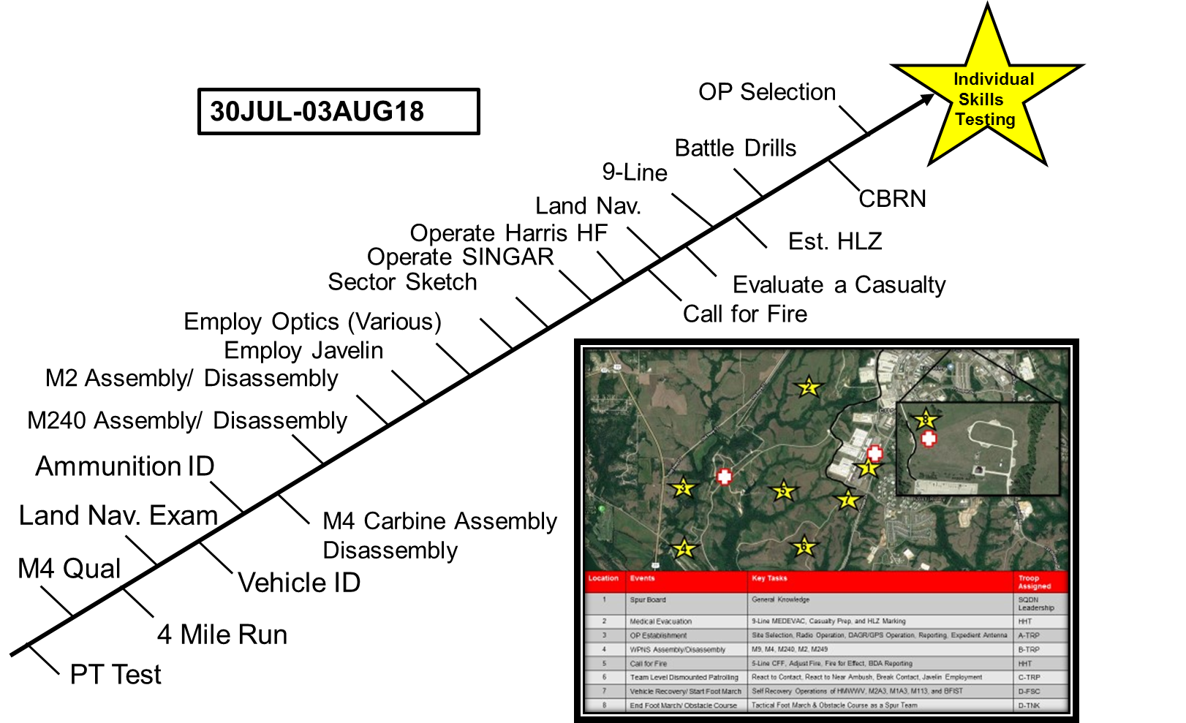
Quarterhorse Training Highlight
Mission: 1-4 Cavalry executes Quarterhorse Academy NLT 30JUL - 03AUG18 IOT train and test individual Soldiers on basic and advanced skills in a complex environment within FRKS.
Intent for Training:
Train at the individual Soldier level on skill level 10 specific Tasks.
Execute Training Tasks that closely reflect the Excellence in Armor training event.
Abide by both the Reconnaissance and Security Fundamentals at all levels during operations.
Certify individual Soldiers on basic skills
Exercise Mission Command at the Squadron and Troop level during both events.
Execute Sustainment Operations as a Squadron.
Conduct SOP validation and refinement throughout the duration of the exercise.
Critical Tasks
Land Navigation (Practical and Written Exam)
Ammunition Identification
Vehicle Identification
Acquire a Target (07-5-1201)
Operate a Single Channel Voice Radio Station (FM) (11-5-0102)
Conduct Surveillance (07-5-1001)
Break Contact (07-3-D9505)
React to Indirect Fire (07-3-D9504)
React to Ambush (Near) (07-3-D9501)
Conduct Actions on Contact (07-3-9013)
Fire a Mortar Adjust Fire Mission (07-3-3054)
Treat Casualties (08-2-0003)
Evacuate a Casualty (08-2-0004)
Establish an Observation Post (07-3-9016)
End state: Quarterhorse Soldiers are trained and certified on individual tasks, prepared to execute Decisive Action Operations at the NTC.
Quarterhorse Academy

Slide 34
Getting After the BRO Big 5
Maintain the Welfare of Soldiers
Marksmanship
Medical
During preliminary marksmanship instruction, instructors-trainers emphasize initial learning by reviewing, reinforcing, and practicing the basics.
Organize Basic and Advance Rifle Marksmanship and conduct preliminary rifle instruction, concurrent and reinforcement training.
1-4 CAV continues to execute small range densities on both 17-18JUL2018 and in concert with Make-Up Gunnery
CLS:
Troopers expiring through December 2018 = 153
Recertification dates: July, August, October 2018
Recertification must become a priority IOT maintain CLS certification for an additional 12-months and through the European Rotation.
Continue to leverage the Squadrons assets to overcome shortfalls by giving junior NCOs and Soldiers opportunities to plan, develop and execute training. At the same time continue to also maintain unit readiness.
100-90%
75-89%
74% and below
Train Soldiers
Maintenance / Communications
Set the Example
Conducting mounted and dismounted land navigation, collecting intel and serving as members of observation and listening posts.
Continue to train and gain a better understanding when employing a screen line and conducting the seven fundamentals of reconnaissance and security.
Troops will continue to build morale by organizing squad competitions for PRT.
Continue to enforce proper recovery is being conducted after all field exercises on all vehicles.
Proper distribution of 5988-E’s is being conducted and completed to standard.
Continue to gain a better understanding on the JCR and HF radio system.
Sustain
Continue emphasis on readiness by staying ahead on HR metrics, getting the right personnel to schools, maintenance and looking out for the well being of Soldiers and their families.
Needs Improvement
Lessons learned from Gauntlet leading into the next quarter. NBC, JCR, CASEVAC, and TOC Battler Drills.

Slide 35
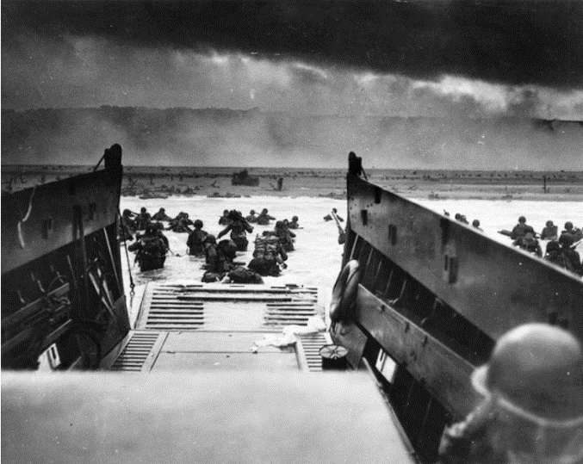
Iron Rangers – 4th QTB / FY18
Commander: LTC Conover
CSM: CSM Jefferson

Slide 36
Iron Rangers Mission
Current:
Iron Ranger builds readiness and lethal teams capable of rapidly deploying to conduct the full range of military operations to seize, and exploit the initiative to accomplish any mission, anywhere, at any time.
DA Directed:
Iron Rangers close with and destroy enemy forces using fire, maneuver, and shock effect, or to repel his assault by fire and counterattack.

Slide 37
Iron Ranger 6 Intent
Purpose: The purpose of the 4th Quarter Training cycle is to validate the battalion’s readiness to deploy and win in combat.
Key Tasks:
Maximize Marksmanship and Maneuver Training – Double the combat capability of this battalion through effective marksmanship and force on force maneuver training; Train relentlessly to achieve exceptionally lethal Tank crews, Javelins gunners, and infantry squads; Achieve platoon proficiency in react to contact, platoon attack, and establishing overwatch/support by fire.
Identify and Leverage White Space – All white space should be filled with Big 5 training (Shooting, PT, Medical, Movement/Maneuver, and Communications). Be efficient with time – find the white space and organize/prepare leaders to maximize training within it;
Exercise Effective Mission Command – Establish the Rear-Detachment prior to NTC; Man and train our CPs to rapidly establish or tear down and to provide a common operational picture to enable shared situational awareness and decision making within this battalion; Develop simple plans rapidly which synchronize the warfighting functions with maneuver.
Build Educated and Active Leaders – Maximize tactically focused LPDs oriented on the key tasks we will need to perform in combat at the Platoon, Company, and Battalion levels; Execute tough, realistic training while preventing accidents and injuries through active leadership!
Care for Iron Rangers and their Families – Establish robust FRG alert rosters to (include parents) to maximize information dissemination and help families manage expectations; stress communication and marriage retreats; remain transparent through responsive and engaged Leaders; Closely manage the integration of new team members and their families.
End state:
IRON RANGERS are confident, aggressive, absolutely the best shooters in this Brigade Combat Team, and fully prepared to dominate the opposition at NTC or in combat.
Equipment is clean and well cared for; all parts for faults and deficiencies are on order.
Families are aware of the training cycle and Soldiers are released routinely at 1600 when not in the field.

Slide 38
Iron Rangers METL Assessment
Mission Essential Tasks | 4QTR/FY18
 | Devil Prowl | Danger Gauntlet | NTC 18-05 | END STATE (OBJ – T)
(07-BN-1028) Conduct an Area Defense | T- | T | T | T
(07-BN-1072) Conduct a Movement to Contact | T- | T | T | T
(07-BN-1092) Conduct an Attack | T- | T | T | T
(07-BN-1272) Conduct Area Security | P | T | T | T
(55-BN-4800) Conduct Expeditionary Deployment Operations at the Battalion Level in support of Offense, Defense, Stability and DSCA | T- | T | T | T
DA Standardized METL: Effective Date - October 2017
End of 4th QTR rating contingent upon personnel strength (e.g., 85% present during training).

Slide 39
Training Highlight – NTC Training Objectives
Battalion Staff
Execute an effective battle rhythm
OPSYNC
LOGSYNC
Maintenance Meeting
BUB
Run an effective Current Operations Cell which enables this battalion through:
A Common Operational Picture of the threat, units locations and current plans
Tracking of key stats required to enable decision making
Develop simple plans rapidly which:
Synchronize the WFFs with Maneuver
Enable effective battle tracking
Sequence actions to sustain pressure on the enemy
Outputs: OPORD, Graphics, Synch Matrix, DSM
Execute Useful Rehearsals
Companies
Execute a Company Battle Rhythm to hold subordinates accountable for the execution of:
Prep 5 Tasks
TLPs
Rehearsals
Develop and clearly articulate simple and effective plans:
OPORD Briefs which allow subordinates to visualize and understand
Detailed enemy analysis
Get to the Rehearsals!
70% of the time from receipt of Company Boundaries & Task/Purpose should be dedicated to rehearsals
Provide active and engaged leadership to mitigate risk and ensure success
Platoons
Execute the Prep 5 Tasks EVERYDAY
Execute PMCS/Maintenance Activities
Boresight/Zero weapons systems daily
Correct and Inspect Load Plans
Execute a COMMEX (JCRs included)
Ensure each vehicle has the correct Classes of Supply
Rehearse constantly
Maneuver Aggressively
React to contact
Overwatch/Support by Fire
Platoon Attack
Maintain all Company and Platoon Property
Safety
Zero accidents

Slide 40
Getting After the BRO Big 5
Maintain the Welfare of Soldiers
Marksmanship
Medical
Table I-VIII: All 68W’s are current for Table VIII through OCT 2018.
CLS Training Scheduled: CLS training scheduled for 23-27 JUL. BN runs 2 x CLS courses per quarter to keep current.
Continue to execute SQD Competition (Each month will be a rotational PT competition created and organized at the CO level for the BN) to set conditions for FY 18 and continue cultural shift within the formation.
Continue individual weapons densities to maintain > than 80% across all systems.
Reinforcing integrated weapons training strategy to ensure lethal Soldiers at the ground qualification level on weapons systems prior to moving to platforms.
100-90%
75-89%
74% and below
Train Soldiers
Maintenance / Communications
Set the Example
Individual Soldier training focused on Skill Level 1 tasks.
Maintain and build depth across all Deployment Readiness requirements and billets within the battalion.
Reinforcing BDE VALEX requirements as battle drills within the BN (recovery, rail load, etc.)
Continue to partner with 1 ABCT as available to provide OJT to 91 series Soldiers
Maximize opportunities for maintainers to attend H8 certification.
Continue to run and improve BN RTO academy focused on ABCT platform specific systems.
Sustain
Continue emphasis on Master Gunner program and coordination and rapport with schoolhouse to create Master Gunner core team in the BN and BDE.
BN Infantry Marksmanship Competition
Needs Improvement
Continue to capture lessons learned (NTC SPT) and ABCT specific functions to codify BN level SOPS (TACSOP, TOCSOP).

Slide 41

Dreadnaughts – 4th QTB / FY18
Dreadnaughts
Commander: LTC Ruzicka
CSM: CSM Szymaszek

Slide 42
Dreadnaughts Mission
2-34 AR trains, build readiness and delivers lethal Platoons & Companies capable of combined arms maneuver. 2-34 AR is capable of rapidly deploying anywhere in the world to conduct the full range of military operations to seize, retain, and exploit the initiative to win against any adversary.

Slide 43
Dreadnaught 6 Intent
Expanded Purpose: Build and maintain readiness at the Company and below level to capitalize on Collective training in 4th QTR
4th QTR Key Tasks:
(1) Provide qualified Platoons and Companies to support NTC rotation 18-10
(2) Integrate Battalion mission command nodes into every training opportunity.
(3) Maintain lethal individuals, teams, and squads/sections to set conditions for the NTC and FY19 Q1.
(4) Conduct a deliberate leader development program focused on building lethal platoons
4th QTR Endstate: 2-34 AR capitalizes on collective training at the National Training Center, continues to build lethality at the Crew, Platoon, and Company level, and is prepared to deploy worldwide, in support of Combatant Commander requirements.

Slide 44
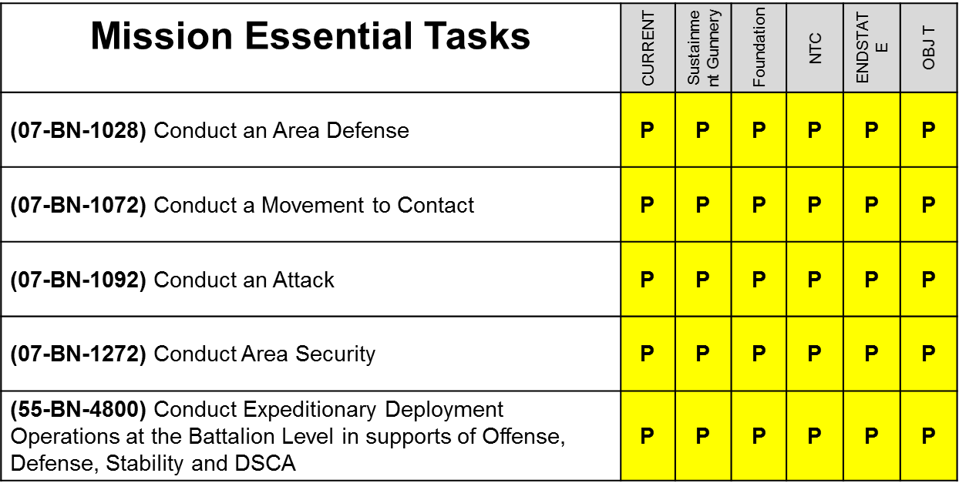
Dreadnaughts METL Assessment
METL ASSESMENT
OBJ T assumes 80% aggregate present at training, with >75% of leadership present at echelon. Based on manning we do not meet the requirements for a T rating in any MET.

Slide 45
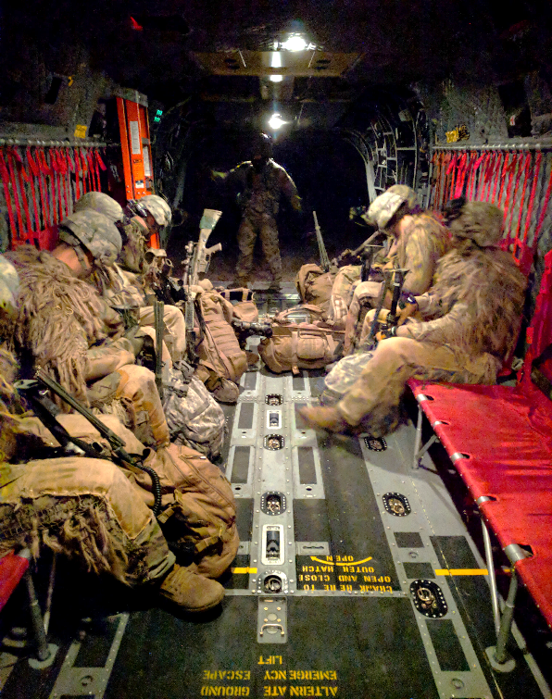
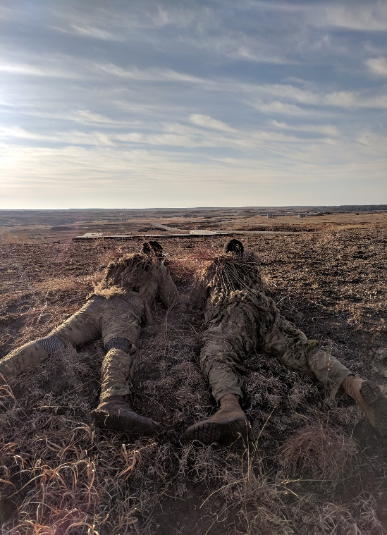
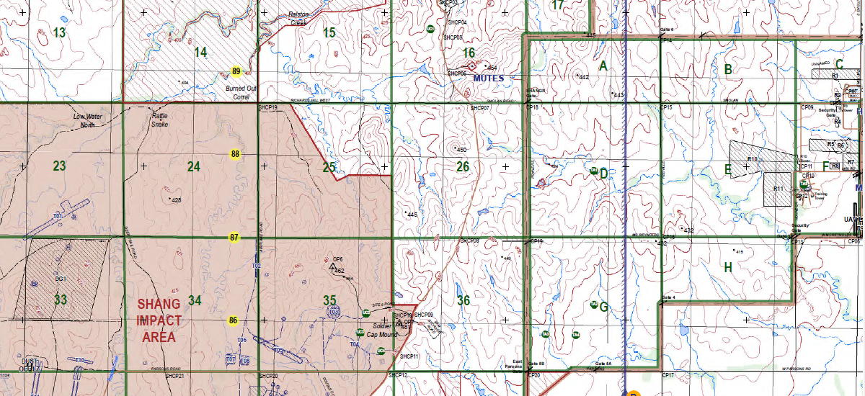
Training Highlight
BN Mission: NLT 100100JUN18 (H hr) 2-34 AR attacks to clear OBJ KOALA IOT deny the CAB's ability to provide aerial combat power in support of 1/1ID
BN CDR's Intent:
Purpose: deny 1/1ID and 1st CAB ability to mass combat power on FR units
Key Tasks: 1) Conduct stealthy and deliberate reconnaissance to identify locations of HPTs; 2) Synchronize all assets to ensure neutralization of ADA and destruction of HPTs; 3) Minimize TOT with a well synchronized and rehearsed ground tactical plan
Endstate: 1) Minimize loss of FR assets; 2) neutralize 1/1ID ability to mass aviation assets; 3) Popular support for Donovians increased; 4) Minimize time on Smokey Hill
Tasks to Be Trained
Area Reconnaissance
Zone Reconnaissance
Conduct a Screen
Conduct an Air Assault
Engage Enemy with Indirect Fire
Conduct Troop Leading Procedures
Top Left: Sniper Section loads aircraft and checks equipment in preparation for the night air insertion
Reconnaissance Guidance: Area Recon
Tempo: Stealthy and Deliberate
Focus: Enemy – TAA, FARP, ADA assets, maneuver elements/security posture; Terrain – Key Terrain
Engagement Criteria: Engage only when compromised and decisively engaged
Disengagement/Displacement Criteria: Any IDF/DF contact
Bottom Right: Snipers occupy final firing position in a two-man team. Reporting to the Mission Support Site
Bottom Left: Scheme of Maneuver includes 7km Stalk with Alternate and evade routes
85
PL Hawaii
PL Oregon
PL Wyoming
PL Kansas
OBJ Antelope
88
PL Hawaii
PL Oregon
PL Wyoming
1
3
OBJ Koala
87
2
HLZ Jaguar
PL Kansas
PL Maine
86
PZ Lion
PL Ohio
00
01
02
03
04
05
06
07
08
09
10

Slide 46
Getting After the BRO Big 5
Maintain the Welfare of Soldiers
Marksmanship
Medical
Continue to focus on individual weapons training by facilitating a high level of integration prior to moving to stabilized platforms.
Table I-VIII: All 68W’s have completed Table 8 for this term and are up to date on NREMT requirements.
CLS Training Scheduled: BN runs 2 x CLS courses per quarter to keep current.
100-90%
75-89%
74% and below
CDDP (Focus Areas, Rail load, UMOs)
Sustainment operations, 5988s, LOGSTAT
Deploy and establish key mission command and sustainment nodes, (complete BN SOPs), TOC, TAC, CTCP, UMCP, and FTCP.
Continue to build cohesive and lethal crews, working / AGTS, BATS, CCTT, Chair Drills….
Train Soldiers
Maintenance / Communications
Set the Example
Continue to focus on FM/JCR in all track and wheeled vehicles.
Maintain Upper TI, AFATDs, VoIP, NIPR, SIPR, DCGS….
Cross train Soldiers and Leaders on JCR graphics, overlays, and Orders process
Sustain
Continue the continuity of communication within the BN to BDE (CPOF Reports and Data push)
Needs Improvement
Graphics over JCR
Orders to Company Commander
CARs, Sustainment, Fires

Slide 47

Burt’s Knights – 4th QTB / FY18
Burt’s Knights
Commander: LTC Dodd
CSM: CSM Petty

Slide 48
3-66 AR Mission
Burt’s Knights close with and destroy enemy forces using fire, maneuver, and shock effect, or to repel his assault by fire and counterattack.

Slide 49
3-66 AR Commander’s Intent
Expanded Purpose: Provide sustained, trained, and lethal platoons certified on individual, team, and platoon tasks capable of executing any mission, anywhere, anytime. 3-66 AR continues to be combat ready now to support any assigned mission.
Key Tasks:
Sustain readiness of Soldiers, crews, and squads to generate lethal platoons and companies through combat focused training leveraging Live, Virtual, Constructive, and Gaming Integrated Training Environment -actively seek and include multi-domain / multi-echelon assets in all training.
Mitigate impact of personnel shortages by identifying CDR/GNR teams with longevity to maximize number of qualified crews and sustain gunnery proficiency through AGTS/CCTT.
Execute comprehensive services covering vehicles, weapons, Soldiers, and Families to ensure we maintain our equipment to 10/20 standard.
Develop Soldiers and leaders through LPDs, Team Leader Course, and institutional training to create leaders who are confident, competent, and strong.
Continue to refine BN systems to achieve a rapid deployment posture across the BN through CDDP courses and company/battalion level EDREs.
Take care of our Soldiers and Families through the FRG to maintain Soldier Family resiliency and readiness.
Endstate:
The Burt’s Knights Battalion stands as a lethal formation always ready to deploy, fight, and win. At the end of 4th QTR FY 18, 3-66 AR is a highly trained and ready Combined Arms Battalion that is prepared to execute any mission, anytime, anywhere with the mindset of “No Mission Too Difficult, No Sacrifice Too Great, Duty First.” Through an integrated and responsive FRG, our BN minimizes stressors to our Soldiers’ Families.

Slide 50
3-66 AR Battalion METL Assessment
Mission Essential Tasks | 4th QTR / FY 18
 | Begin 4th QTR / FY 18 | Sustainment Gunnery | Devil Foundation 2.0 | NTC 18-10 | OBJ-T ENDSTATE | SUBJ-T ENDSTATE
(07-BN-1028) Conduct and Area Defense | T | T | T | T | T | T
(07-BN-1072) Conduct a Movement to Contact | P | P | P | T | T | T
(07-BN-1092) Conduct an Attack | T | T | T | T | T | T
(07-BN-1272) Conduct Area Security | P | P | P | T | T | T
(55-BN-4800) Conduct Expeditionary Deployment Operations | T | T | T | T | T | T

Slide 51
Training Highlight – Crew Readiness
Qualified Crews (Post Gauntlet)
Qualified Crews (Post Sustainment Gunnery)
Platform | Slant | % Qual
M1A2 | 9/29 | 31%
M2A3 | 12/18 | 67%
BFIST | 1/3 | 33%
MMG | 1/5 | 20%
CPP | 0/6 | 0%
Platform | Slant | % Qual
M1A2 | 20/29 | 70%
M2A3 | 18/18 | 100%
BFIST | 3/3 | 100%
MMG | 4/5 | 80%
CPP | 2/6 | 33%
MORTEP
23JUL-27JUL at Range 53
Qualification of 2 new mortar crews (3/4 M1064 Crews Qualified for NTC)
Table V-VI: Split Section, FPF, Search & Traverse, Coordinated Illumination
Crews will conduct each mission mounted and dismounted
Testing the effects of mortars used to breach triple-strand C-wire
B Co/1st ENG to construct the obstacle

Slide 52
Getting After the BRO Big 5
Maintain the Welfare of Soldiers
Marksmanship
Medical
---As of 8 June---
Currently manned 3/9 rifle squads
Tank companies manned at 4/6 platoons
Scout platoon has one truck manned
---By NTC---
Project 6/9 rifle squads
4/6 tank platoons
Trucks and Brads manned for Scout PLT; dismounts will not be manned
Table I-VIII: All 68W’s project to complete Table VIII training IAW SOP prior to expiration. There are a total 5 personnel enrolled into BLS training and an additional 6 personnel pending enrolment into Class VIII training after Gauntlet.
CLS Training Scheduled: No issues maintaining CLS qualified with a 1:4 ratio.
Note: APFT data includes FMTs with their companies; deployability
status does not include FMTs with their companies
CSM and1SGs hold a weekly meeting to discuss the above data
Out of the 11 chapters (legal): 3 x are waiting on orders; 2 x need a separation board; 3 x pending CIF; 2 x pending CDR signatures; 1 x inpatient
Company CDRs override applicable profiles once per week
Train Soldiers
Maintenance / Communications
Set the Example
Gauntlet: communication, synchronization/integration, movement techniques, defensive and offensive operations
July Gunnery will be tank heavy due to incoming gains
Solidify SOP for FAS/MAS in conjunction with the PACE and who to send reports to; work reporting systems from MEDO through CTCP to BDE
Continue to enforce JCR upkeep; goal is always 100%; paints the picture on the battlefield
Overall better FM usage due to Devil Prowl and Gauntlet
Maximizing time and space for services
Sustain
Continue to minimize non-deployables
Continue to promote 20 and 30-levels smartly
Needs Improvement
Communication from top down; don’t assume that PSGs know—1SGs sometimes have to state implied tasks
Continue to build the team; the BN will have a lot of new faces post-NTC
As of 9 June 18

Slide 53

Destroyer – 4th QTB / FY18
“Hamilton’s Own”
Commander: LTC Iven T. Sugai
CSM: CSM Kazimier R. Kazimierowski

Slide 54
Destroyer Mission
Current:
NLT 4th QTR FY18, Team Destroyer builds readiness and lethal teams on FRKS capable of rapidly deploying anywhere to provide lethal fires in support of 1 ABCT operations, provide trained fire support personnel to the maneuver battalions, and provide target acquisition capabilities to the brigade.
DA Directed:
Team Destroyer provides command, control, and administrative supervision of organic and attached Field Artillery units.

Slide 55
Destroyer 6 Intent
Expanded Purpose: Provide direct support to 1ABCT with field artillery, fire support, and target acquisition assets.
Key Tasks:
1) Certify and qualify at echelon across all elements.
2) Maintain high state of readiness with a non-deployable rate below 10% and OR rate above 90%.
3) Develop and certify leaders through challenging and realistic training and comprehensive professional development.
4) Master Individual Soldier Tasks and Drills, collective tasks, and METL tasks through Mission Command and Multi-Echelon training.
5) Care for Destroyer Soldiers and Families through responsive and engaged Leaders.
End State:
Team Destroyer is complete with collective training with personnel and equipment ready for deployment. Training time is efficiently used and Soldiers have opportunities to enjoy personal time prior to deployment. Total Force and community partners maximize training opportunities and increase Soldier’s quality of life. Families are integrated in FRGs and prepared for unit deployment.

Slide 56
Team Destroyer METL Assessment
Mission Essential Tasks | 3rd QTR/FY18
 | CURRENT | Devil PROWL | NTC LTP | GAUNTLET | OBJ-T Endstate | Subjective T Endstate
(06-BN-1021) Control Field Artillery Operations | T- | T- | T- | T | T | T
(06-BN-2006) Direct the Employment of Field Artillery Acquisition Assets | T | T | T | T | T | T
(06-BN-5001) Conduct Battalion Fire Missions | T- | T- | T- | T | T | T
(06-BN-5076) Synchronize Fires | T- | T- | T- | T | T | T
(06-BN-6011) Conduct Fires | P | P | P | T | T | T
(55-BN-4800) Conduct Expeditionary Deployment Operations at the Battalion Level in Support of the Offense, Defense, Stability and Defense Support of Civil Authorities (DSCA) | T- | T- | T- | T | T | T

Slide 57
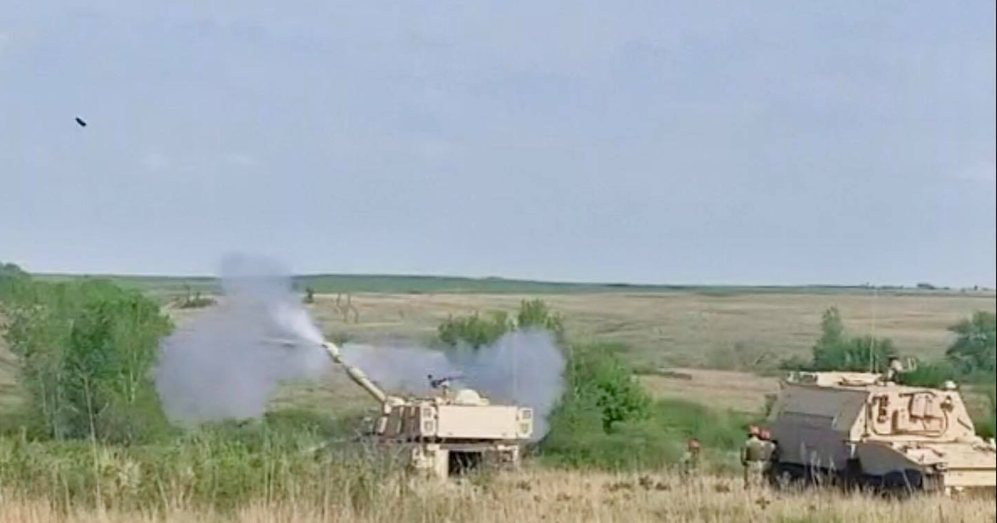
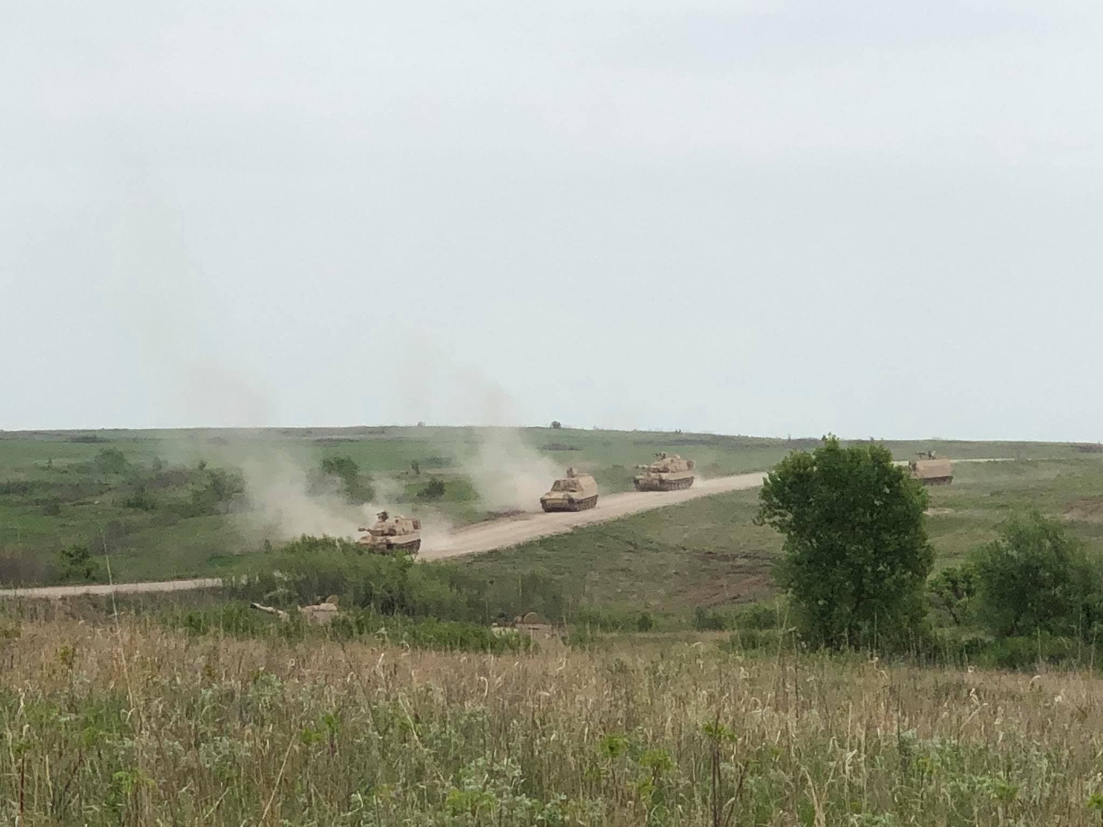
Training Highlight – OPNET 3
Mission: 1-5FA trains and fields on the M109A7 Paladin and M992A3 CAT at Fort Riley, KS from 10APR18 – 15MAY18 in order to validate the equipment and begin the transition from the A6/A2 fleet as the Army’s First Unit Equipped.
Key Tasks:
Receive expert training from the BAE civilians who helped design the system.
Train and certify leaders on the equipment throughout the OPNET.
Use the process to train on METL tasks.
Complete the nearly 1 year long process of fielding and training on the A7/A3 family of vehicles successfully.
Mission Essential Tasks | Initial | Endstate
(06-BN-1021) Control Field Artillery Operations | T- | T-
(06-BN-2006) Direct the Employment of Field Artillery Acquisition Assets | T | T
(06-BN-5001) Conduct Battalion Fire Missions | T- | T-
(06-BN-5076) Synchronize Fires | T- | T-
(06-BN-6011) Conduct Fires | P | P
(55-BN-4800) Conduct Expeditionary Deployment Operations at the Battalion Level in Support of the Offense, Defense, Stability and Defense Support of Civil Authorities (DSCA) | T- | T-
Way ahead for Gauntlet
Transition from section and platoon level training to BTRY and BN.
Integrate maneuver into tactical plan to get out of the PAA mindset.
Update TACSOP and TOCSOP, validate during Gauntlet in preparation for NTC

Slide 58
Getting After the BRO Big 5
Maintain the Welfare of Soldiers
Marksmanship
Medical
APFT
Company | Assign | Pass # | Alt APFT | HW Failure | >270 | 300 | AVG | Pass %
HHB | 190 | 153 |  | 8 | 12 | 2 | 223 | 90%
A BTRY | 103 | 96 |  | 5 | 35 | 5 | 260 | 93%
B BTRY | 40 | 36 |  | 2 | 2 | 0 | 227 | 90%
D BTRY | 93 | 68 |  | 3 | 2 | 0 | 236 | 73%
F FSC | 105 | 83 |  | 10 | 36 | 2 | 248 | 79%
WPN SYS | MTOE | Assign | Day | Expert | % Qualified
M4 | 674 | 523 | 291 | 44 | 56%
M249 | 21 | 21 | 10 | 4 | 48%
M240 | 33 | 33 | 15 | 0 | 45%
M2 | 54 | 54 | 37 | 0 | 69%
MK19 | 43 | 43 | 13 | 0 | 30%
JAV/CLU | 0 | 0 | 0
M9 | 26 | 26 | 9 | 3 | 35%
M320 | 31 | 31 | 20 | 0 | 65%
Medical Training
Company | CLS | Table 8 | EMT | CPR
HHB | 25 | 18 | 18 | 18
A BTRY | 32
B BTRY | 20
D BTRY | 16
F FSC | 22
BN Total | 115/197 | 18/18 | 18/18 | 18/18
UNIT NAME | AUTH | ASGN | ASGN% | DEP | MRC3 | MRC4 | AWOL | LEGAL | ADMIN | DWELL | ND TOTAL | ND TOTAL%
HHB | 112 | 115 | 102.68% | 0 | 8 | 2 | 0 | 7 | 0 | 0 | 17 | 14.78%
A BTRY | 97 | 101 | 104.12% | 0 | 5 | 0 | 0 | 1 | 0 | 0 | 6 | 5.94%
B BTRY | 45 | 39 | 86.67% | 0 | 1 | 0 | 0 | 1 | 0 | 0 | 2 | 5.13%
D BTRY | 118 | 94 | 79.66% | 0 | 11 | 1 | 0 | 3 | 0 | 0 | 15 | 15.96%
F FSC | 83 | 104 | 125.30% | 0 | 8 | 1 | 0 | 4 | 0 | 0 | 13 | 12.50%
All medics are TBL VIII, EMT, and CPR certified until 2020
Increase complexity of training through use of casualties
BRO Prep
100-90%
45-89%
44% and below
Scheduled M4 and MG ranges weekly through July and August following block leave to bring up numbers
NCOPD – Deployment Operations
Continuing improvement of counseling
program
Train Soldiers
Maintenance / Communications
Set the Example
Bro Time Training – complexity through
CBRNE focus
Team Leader Academy
NCOPDS/Functional courses
Battlefield adaptability
Exercise Digital Communications weekly
Weekly AAO LPD
Recovery Ops
Maintenance expertise-unique artillery equipment
Professional development schools

Slide 59

Diehard – 4th QTB / FY18
Commander: LTC Gilge
CSM: CSM Kammer

Slide 60
Diehard Mission
Current:
NLT 4th QTR FY18, 1st Engineer Battalion builds readiness and lethal teams on FRKS capable of rapidly deploying anywhere to (1) conduct mobility/counter-mobility/survivability operations, (2) conduct intelligence collection and analysis, (3) deliver reliable and redundant communication, and (4) provide mission command and conduct support area security with task organized units, IOT enable 1st ABCT decisive action.
DA Directed:
Diehards provide Mission Command (MC) and supervision of the tactical operations of the BEB, ABCT and all assigned/attached Operational Control (OPCON) units in support of the ABCT commander and staff.

Slide 61
Diehard 6 Intent
Expanded Purpose: The 1st Engineer Battalion integrates to build lethal company and above teams and enables Devil Brigade decisive action in the 4th QTR. It refines its skills at multiple echelons to synchronize engineer operations, integrate ALL enablers, and secure the consolidation / support area effectively.
Key Tasks:
Integrate all enablers to maximize the combat effectiveness and capabilities of all units and be exceptional team players with the other battalions and the BCT
Synchronize the engineer effort across the BCT AO focusing on combined arms breaching in the offense and EA development in the defense
Effectively secure the consolidate area / support area to include employ TCF, indirect fires, route security and clearance, and proactive area security
Conduct deliberate recovery before and after NTC while maintaining scheduled services in tolerance and building deployable supply packages and equipment on-hand.
Develop and certify leaders through professional development program, PME, school, and Best Sapper Competition opportunities.
Exercise our rear detachment to take care of Soldiers who are integrating in or transitioning out of 1EN while minimize training distractions
Take care of our families with strong Family Readiness Groups
End state:
1EN trained to a T1 and successful at NTC; DH enabler teams integrated, organized, and postured to continue follow-on operations; Engineer effort synchronized to maximize all engineer resources the most effectively and provide Devil BDE with maximum capabilities; Rear De able to minimize training distractions while continuing to conduct routine activities and build combat power in rear. Families able to react to the challenges of day to day life without their Soldier.

Slide 62
Diehard METL Assessment
Mission Essential Tasks
4th QTR, FY 18
Mission Essential Tasks | BEGIN 4TH QTR | NTC LOADOUT | NTC | ENDSTATE
(05-BN-0010) Plan Engineer Support to Mobility Operations | T | T | T | T
(05-BN-0012) Conduct Engineer Countermobility Operations | T | T | T | T
(05-BN-0013) Conduct Survivability Operations | T- | T- | T | T
(11-BN-9000) Conduct Department of Defense Information Network –Army (DODIN-A) | T- | T- | T | T
(34-CO-3001) Manage Information Collection Requirements | T- | T- | T | T
(55-BN-4800) Conduct Expeditionary Deployment Operations at the Battalion Level in supports of Offense, Defense, Stability and DSCA | P | P | T- | T-
Note: All ratings are “Subjective-T.” Due to Objective-T requirements for leader participation and current manning levels, exceeding a P rating will not be possible under Objective-T.

Slide 63
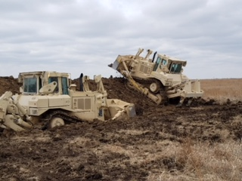
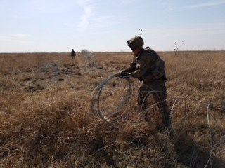
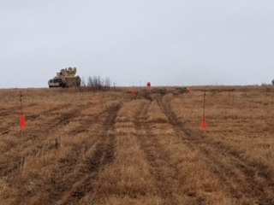
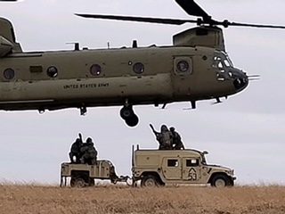
Training Highlight – Devil Prowl
Mission: 1 EN integrates with and enables CABs for Force-on-Force and CALFEX from 10APR18-08MAY18 on Fort Riley, KS to build readiness in preparation for follow-on home station training and NTC 18-10.
Key Tasks:
1. Support and enable Battalion Force-on Force
2. Support and enable Company Live Fires
3. Fully integrate organic and attached enablers into operations
Mission Essential Tasks | Initial | End State
(05-BN-0010) Plan Engineer Support to Mobility Operations | P | T-
(05-BN-0012) Conduct Engineer Countermobility Operations | P | T-
(05-BN-0013) Conduct Survivability Operations | P | P
(11-BN-9000) Conduct Department of Defense Information Network – Army (DODIN-A) Operations | P | P
(34-CO-3001) Manage Information Collection Requirements | P | P
(55-BN-4800) Expeditionary Deployment operations BN Level ISO the Offense, Defense, Stability & DSCA | P | P
Engineer support platoon constructs a berm
Sappers lay a triple standard concertina obstacle
A completed, marked lane through a breached obstacle
Charlie Co slings a retrans team
Way ahead for Gauntlet
Continue integration of attached enabler units (MPs, EAB Engineers), validate the process prior to NTC
Continue to build communication links between Brigade and Battalion staffs in order to help Brigade understand available engineer firepower; exercise parallel MDMP ICW Bde; coordinate engineer effort across BCT AO
Integrate FSO into TOC processes; participate in Brigade FCX
Update TOCSOP and TACSOP, validate during Gauntlet in preparation for NTC

Slide 64
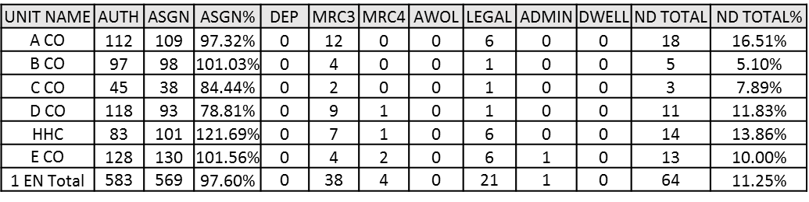
Getting After the BRO Big 5
Maintain the Welfare of Soldiers
Marksmanship
Medical
Increase complexity of training through use of casualties
Point of Injury actions
100-90%
75-89%
74% and below
M4 range 21 June
M249 range 27 June
Night marksmanship
NCOPD – Role of the NCO in Readiness
BRO Prep – Continued use and improvement of the program
Train Soldiers
Maintenance / Communications
Set the Example
Individual understanding of roles and responsibilities within the organization and where they fit “Big Picture”
CBRNE Round Robin as a “high payoff” training event
Functional courses / local schools
Battlefield adaptability
“Rifleman First” mentality
Enable HF capability and expertise
Commo training surge as a “high payoff” training event
BDAR/Recovery ops
Maintenance expertise-unique engineer equipment
Professional development schools
2nd Place, 10th and 11th Best Sapper Teams
Recognize the volunteerism and support to the community

Slide 65

Guardians – 4th QTB / FY18
Guardians
“We Carry the Burden”
Commander: LTC Guida
CSM: CSM Scott

Slide 66
Guardian’s Mission
Guardian Battalion builds readiness of sustainment personnel and equipment in order to enable the Devil Brigade to rapidly deploy and accomplish any mission, any where, at any time.
DA Directed: To provide direct support logistics, field maintenance, and Echelons I and II force health protection (FHP) support to the Armored Brigade Combat Team (ABCT).

Slide 67
Guardian 6 Intent
Expanded Purpose: Generate the highest readiness possible through planned training events in cooperation with installation enablers and those who champion and facilitate deployment of personnel and equipment. Maximize training audience and efforts toward sustaining and exercising systems ISO Gauntlet; concurrently paving the way for NTC 18-10 and beyond.
Key Tasks:
Establish and re-inforce systems across the formation, codify changes in TACSOP.
Maintain high state of readiness with a non-deployable rate below 10%.
Source all required equipment, execute services and maintain OR above 90%.
Utilize all support operations as training events. Conduct every mission as a tactical operation.
Develop and certify leaders for a decisive action environment.
Master Individual Soldier Tasks and Drills, collective tasks, and METL tasks through Mission Command and Multi-Echelon training throughout the Brigade (FSC integration).
Manage personnel losses and gains in order to maintain crew rosters and best use of training resources.
Care for Guardians and their Families through responsive and engaged leaders.
End state: We are a highly disciplined, professional, and trained force that enables the brigade by providing adaptive, responsive and flexible sustainment support. Guardians are proud to be members of the unit, understand their role in sustaining the brigade and are mature and proactive leaders that take care of Soldiers and Families.

Slide 68
Guardian METL Assessment
Mission Essential Tasks | 3rd QTR, FY 18
 | BEGINNING | GUARDIAN STAKES | DEVIL PROWL | LTP | GAUNTLET | ENDSTATE (OBJ T) | END STATE (SUBJECTIVE T)
55-BN-4800) Conduct Expeditionary Deployment Operations | P- | P- | P- | P- | P- | P- | P
(63-BN-0727) Conduct Actions Associated with Area Defense during Offensive, Defensive, Stability and Defense Support of Civil Authorities (DSCA) Operations | P- | P | P | P | P | P | P
(63-BN-1028) Conduct Sustainment Support in an Area Defense | P- | P | P | P | T- | T- | T
((63-BN-1027) Conduct Sustainment Support in a Movement to Contact | P- | P | P | P | T- | T- | T
(63-BN-1092) Conduct Sustainment Support in an Attack | P- | P | P | P | T- | T- | T
(63-BN-1272) Conduct Sustainment Support in Area Security | P- | P | P | P | T- | T- | T
3rd QTR, FY 18 training events do not meet OBJ-T requirement of external evaluation IOT achieve T Ratings. Gauntlet will present the opportunity to hit BN level T ratings. Turnover in leadership may prevent obj “T” prior to NTC.

Slide 69
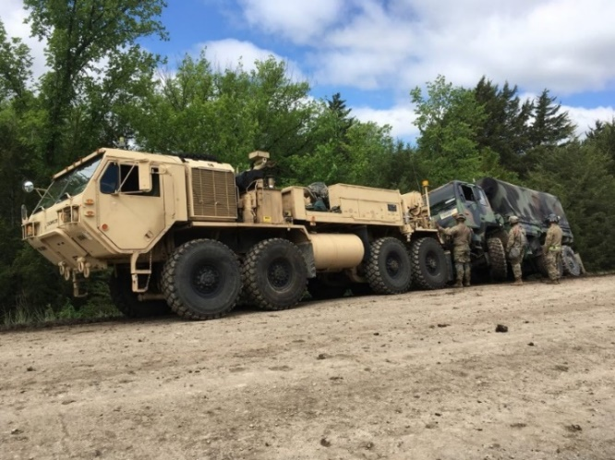
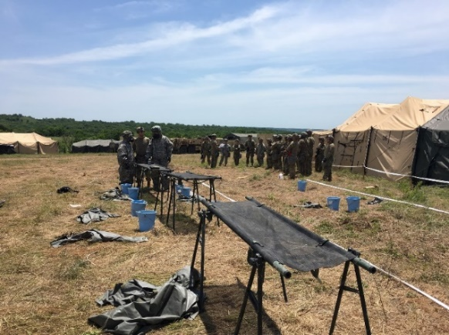
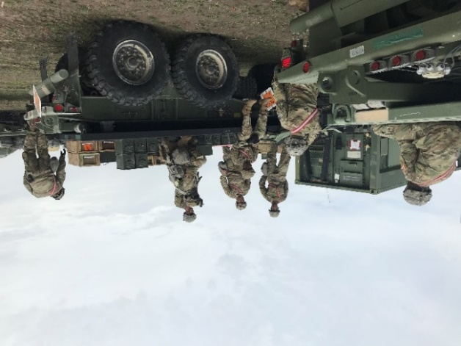
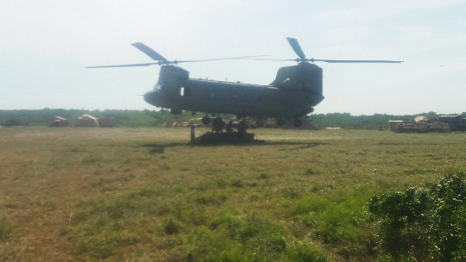
Training Highlight – Devil Prowl / Guantlet
Mission:101 BSB conducted, Devil Prowl and Gauntlet, recovery and weapons qualification during 3rd QT IOT to enhance combat readiness and preparation for NTC 18-10.
Concept of Training Event:
Devil Prowl and Gauntlet was our BN collective training. These major training exercises allowed 101 BSB act as a consolidated effort to support the BDE in force on force training.101 BSB to implement and continued to refine TACSOP and for the BN to be (T) (subjectively) in training.
Training Objectives
Improve/Standardize operations: Codify changes in TACSOP
Conduct weapon Qualification
Establish BSA
Defend BSA and make daily improvements
Conduct Concurrent Training ISO METL
Displace and re-establish BSA in alternate location
Conduct expeditionary SSA Operations
Way Forward
101 BSB will continue refining BSA operations until NTC. SSA is still consolidating ASL into common core containers, Gauntlet helped us refine our capabilities in order to move the BSA with minimal movements. 101 BSB continues the pursuit of readiness.
Impact to unit METL from conducting training event:
Supports Tactical Movements by utilizing convoy operations to and from Maneuver areas ISO BSA FTX.
Supports establish and defend Unit assigned area gun crews to man fighting positions throughout the BSA perimeter in addition to security for LOGPACS moving through the battle space.
Set the conditions for follow training and NTC

Slide 70
Getting After the BRO Big 5
Maintain the Welfare of Soldiers
Marksmanship
Medical
Table I-VIII: 36/41 medics current; remaining medics are scheduled for class
CLS Training Scheduled:
21-24 May 2018
Medical Training:
Continue training internally on medical tasks to support MASCAL operations and ensure synchronization throughout the BDE on CASEVAC/MEDEVAC operations.
UPCOMING RANGES:
M4 (24-25 JUL18)
M9 (25 JUL 18)
M240B/ M249 (24-26 JUL 18)
-AT 4 (31 JUL 18)
Ensure BN maximize every efforts during scheduled ranges
Conducting in-depth profile review meetings with CMD leadership and medical personnel to review profiles, assess affects of BROPREP program; get recommendations/ways ahead to decrease MRC3.
Continue to refine internal systems to move legal and administrative processes forward.
100-90%
75-89%
74% and below
Train Soldiers
Maintenance / Communications
Set the Example
Continue to focus on individual Soldier tasks during BTT to build readiness and prepare for Gauntlet and NTC Rotation 18-10.
Conduct Drivers Training Program to ensure Soldiers are properly licensed and certified for night driving.
NCOPD (Convoy Operations and Counseling)
Reinforce Soldier mindset that supports basic Army programs/regulations (EO/SHARP/MRT)
Continue using the 10-day recovery model on an in-depth level to ensure proper maintenance is conducted.
Conduct routine inspections on equipment during motor stables to ensure proper maintenance is being conducted.
Continue to maximize all opportunities for maintainers to attend H8 training.
Maintain Warfighter Mindset
Continue making the BN leadership development program a priority for junior NCOs
Empower leaders at each level with the area of responsibility that they are assigned to.

Slide 71
Closing Comments / Discussion

Slide 72
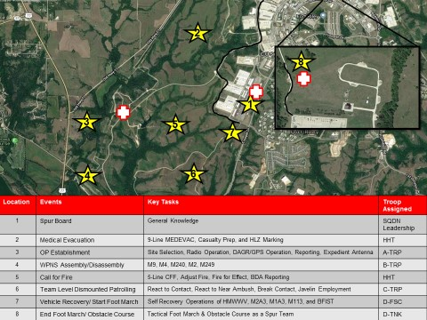
Quarterhorse Academy
OP Selection
Individual
Skills
Testing
30JUL-03AUG18
Battle Drills
9-Line
Land Nav.
CBRN
Operate Harris HF
Est. HLZ
Operate SINGAR
Sector Sketch
Evaluate a Casualty
Employ Optics (Various)
Call for Fire
Employ Javelin
M2 Assembly/ Disassembly
M240 Assembly/ Disassembly
Ammunition ID
Land Nav. Exam
M4 Carbine Assembly Disassembly
M4 Qual
Vehicle ID
4 Mile Run
PT Test

Slide 73
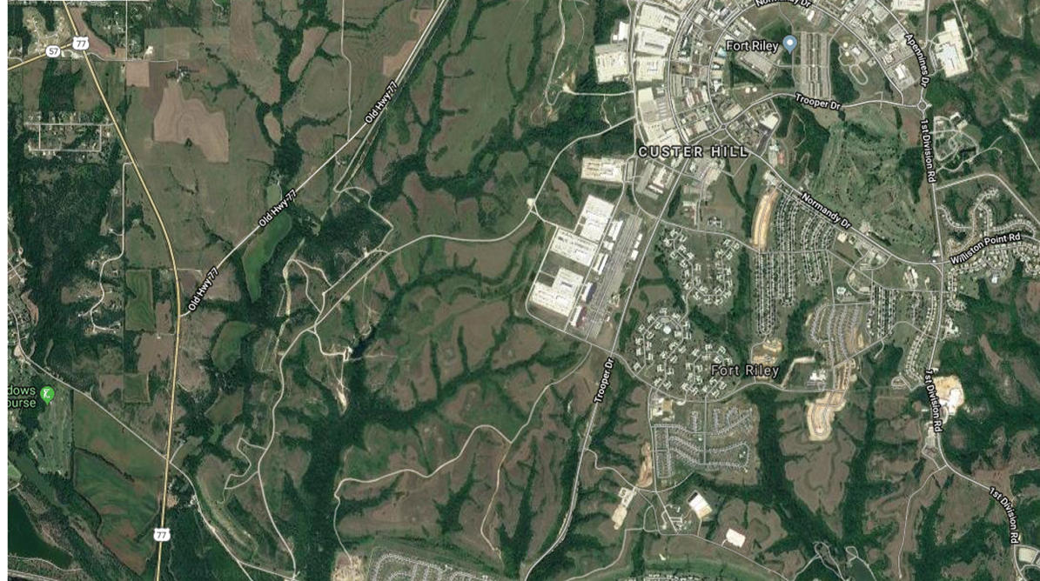
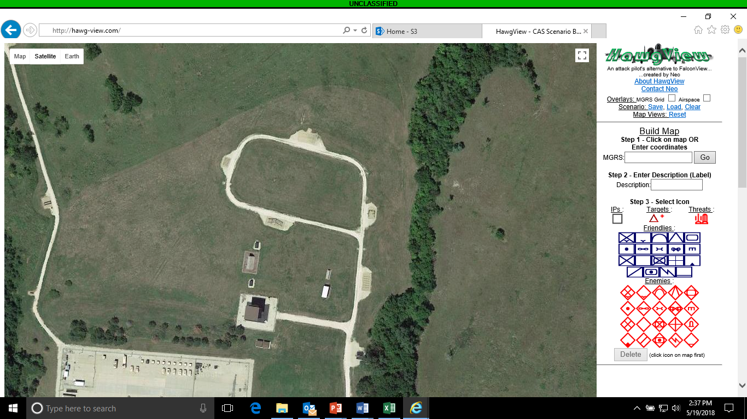
1-4 CAV Spur Ride Concept
2
8
1
3
5
7
4
6
Location | Events | Key Tasks | Troop Assigned
1 | Spur Board | General Knowledge | SQDN Leadership
2 | Medical Evacuation | 9-Line MEDEVAC, Casualty Prep, and HLZ Marking | HHT
3 | OP Establishment | Site Selection, Radio Operation, DAGR/GPS Operation, Reporting, Expedient Antenna | A-TRP
4 | WPNS Assembly/Disassembly | M9, M4, M240, M2, M249 | B-TRP
5 | Call for Fire | 5-Line CFF, Adjust Fire, Fire for Effect, BDA Reporting | HHT
6 | Team Level Dismounted Patrolling | React to Contact, React to Near Ambush, Break Contact, Javelin Employment | C-TRP
7 | Vehicle Recovery/ Start Foot March | Self Recovery Operations of HMWWV, M2A3, M1A3, M113, and BFIST | D-FSC
8 | End Foot March/ Obstacle Course | Tactical Foot March & Obstacle Course as a Spur Team | D-TNK

